Slide 1

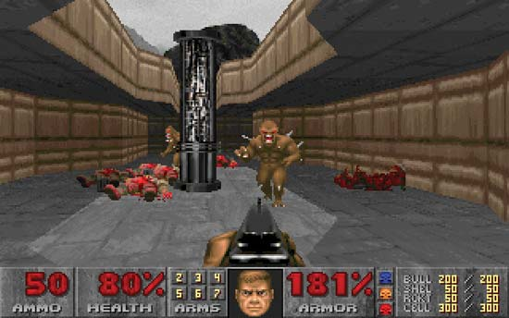
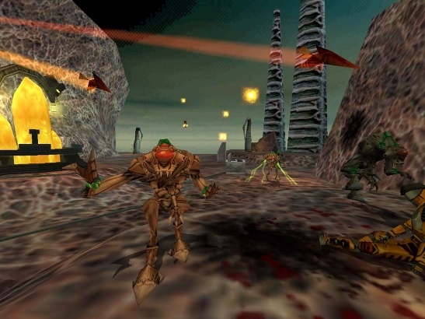
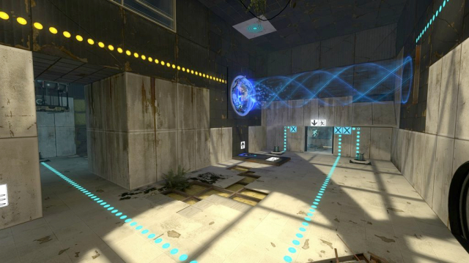
Games and the surrounding technology

Slide 2
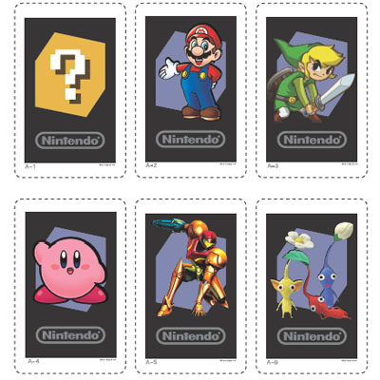
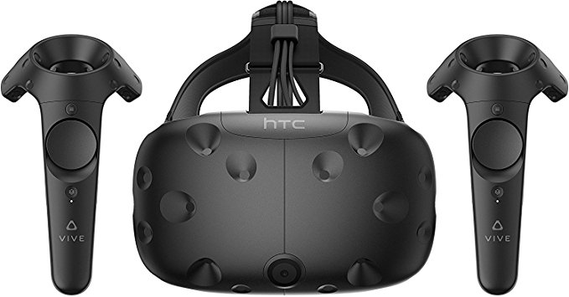
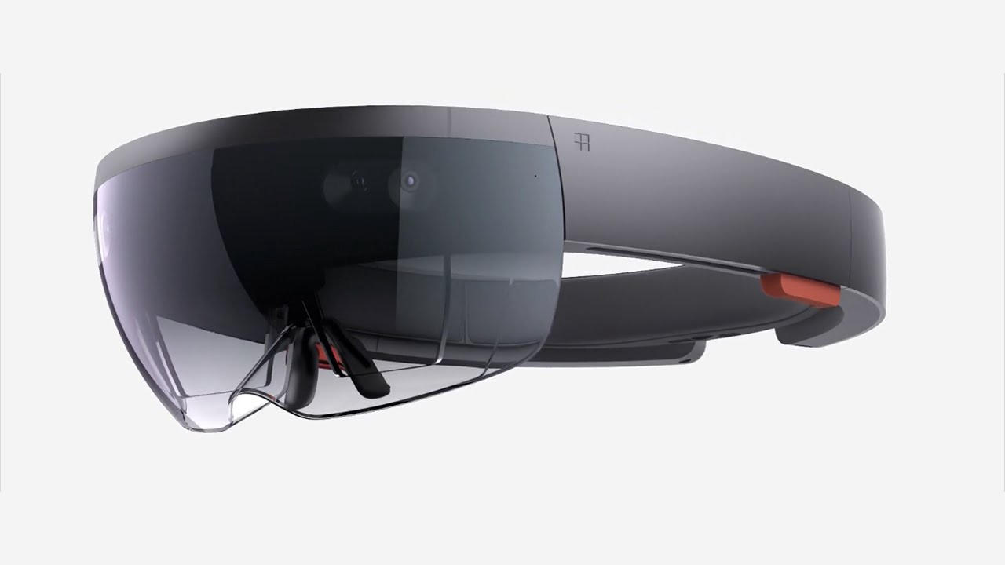
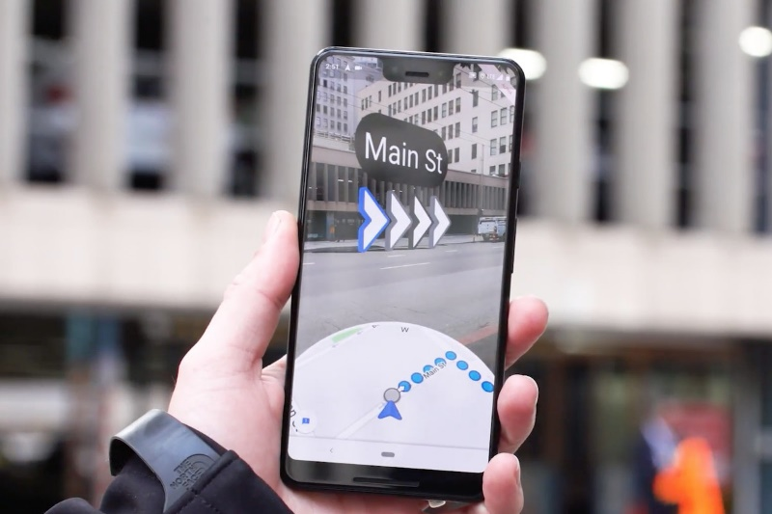
Technologies
Rising technology in the gaming sector includes Augmented Reality (AR) and Virtual Reality (VR). AR has been gaining a lot of momentum especially in the Mobile sector with games such as Pokémon GO releasing in 2016 being largely based around this. However this is not the earliest form of mainstream AR, the 3DS released with AR cards that could model 3D images of Nintendo characters on the screen using rear facing camera’s. Microsoft is trying to enlarge this sector with it’s Hololens developer kit, and is already making the second generation. VR on the other hand has been around for a relatively short while, with the Oculus Rift and HTC Vive being the first mainstream headsets available. They also came around in 2016, however there were problems noted such as light bleeding, weight and wired connectivity reducing from the experience. You also need a large clear room in order to use these headsets. However the market was big enough for Sony to release their PlayStation VR headset allowing for more immersion in titles such as Driveclub, Gran Turismo Sport and even Resident Evil 7.

Slide 3
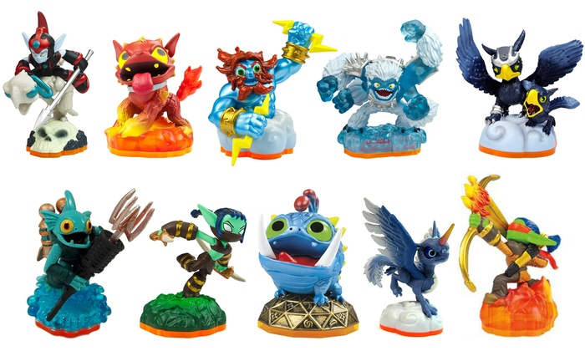
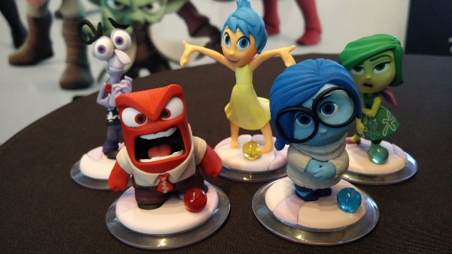

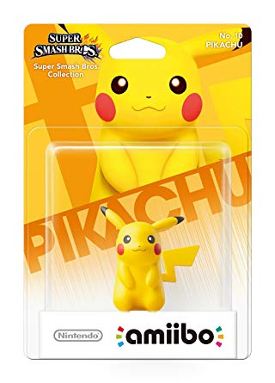
Technologies
Figurines have been joining the market too, adding content to in game worlds via physical objects. Skylanders was one of the first games to do this (2011), however it has been gaining popularity thanks to Nintendo with their collectable Amiibo figures (these were so popular in America that there was a shortage of some figures). Ubisoft and even Lego have started making games using figurines as purchasable content for in game worlds. These have problems including bigger transport costs and they have the ability to be resold to people that would otherwise have to be brought brand new, however the tangibility of the items increases the value proposition to gamers and collectors.

Slide 4
Technologies
Mobile sector- this accounts for 47% of all the games sector revenue, that’s $63.2 billion. Games tend to be more casual, short and addictive, often are “freemium” games (free but pay to gain access to content early). They have many options to allow the player to spend money, be it speeding up gameplay aspects, short time limited item giveaways, or “loot boxes” which are paying for unknown items with one being the chance of a good item. They have to be well optimised, as they are being run on low end chips with little TDP and cooling capability, and also must appear friendly and appeal to most audiences in order to gain player count. The more players you have the more the game will appear on mobile storefronts. On IOS you can be charged from $0-99$ per year based on the application you have advertised on there, on Android devices it will cost £25 one time fee.
//no network access required, portable, fifa points,, easy to pay for items, easy to join, increasing in quality
// less immersive advertisements – rewards if you watch advertisements

Slide 5
Genre’s
There are many different game genres. Each genre caters for certain types of people, each differing in player base size. Some of the largest include FPS (First Person Shooter) however there are in fact many others:
Racing (vehicular or otherwise (Need For Speed)
Platformer (LittleBigPlanet)
MMO (Massively Multiplayer Online (Worlds Adrift)
Arcade (Pac Man Tournament)
Hack n’ Slash (Bayonetta)
RPG (Role Playing Game) (Fallout: New Vegas)
These are just a few examples of genres. Some of these have become very big almost with a cult following such as Fallout and Needs For Speed, however some are quite new and have smaller playerbases. Games with a cult following tend to give a more reliable income for developers, however none will last forever.

Slide 6
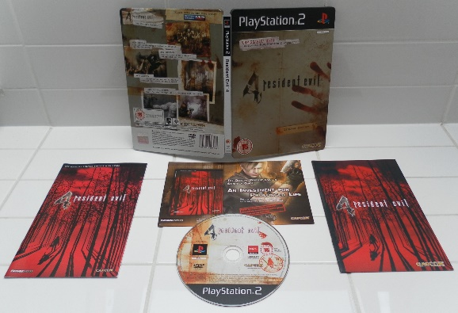



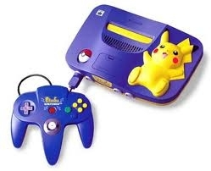

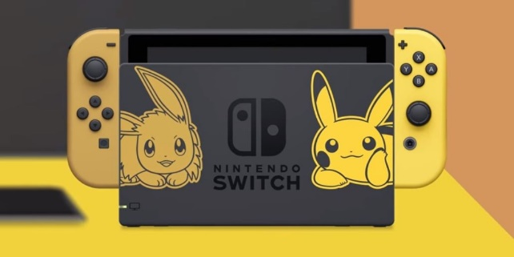
Game trends
Trends in gaming can be formed overnight, or take many years to fully develop. These trends can bring big money to people and companies able to exploit them. For example the Battle Royale trend has created 2 rather large games and boosted the companies to new heights, with PUBG setting it off and bringing in $103 million in February of 2018, and Fortnite claiming $126 million in the same month. Other trends gaming has produced include aforementioned AR and VR as well as the increasing mobile sector.
Merchandise is also a trend in modern gaming with people wanting to flaunt their devotion to a certain series, providing a game is successful of course. Merchandise can be a good way to bring in money and create a more loyal fan base, with some limited edition copies of the game coming with items otherwise unable to purchase. Items can include clothing or plates, even Steelbook™ cases can be prized by people. As time has gone on pre order bonus’ have been giving more tangible items. However some even include DLC that you otherwise would have had to have paid extra for.
Collectors edition consoles are also a large part of the industry, often commanding a higher premium and bundled with other items. These items are decorated with art otherwise unavailable. For example a standard Nintendo Switch retails at £279.99 however the Limited edition Let’s go Pikachu/Eevee edition retails for £339.99

Slide 7

Game trends
A more modern trend in gaming is remastering of original titles. This has been seeing a rise in popularity with both gamers and companies. For example Resident Evil 2 has had a successful remaster to the praise of many fans. Other games to get this treatment include Skyrim, Bioshock and Borderlands.

Slide 8
The end??????????

Slide 9
Sources
My own knowledge (so far)
https://www.theverge.com/2018/3/21/17148918/fortnite-battle-royale-pubg-monthly-revenue-sales-126-million-superdata-research
https://store.nintendo.co.uk/nintendo-switch-console/nintendo-switch-pokemon-let-s-go-pikachu-edition-pack/11897843.html?affil=thggpsad&switchcurrency=GBP&shippingcountry=GB&&source=ppc&gclid=EAIaIQobChMI3rDWor294AIVKL7tCh0WSA26EAQYASABEgLrp_D_BwE
https://www.argos.co.uk/product/6836539
https://www.gamesindustry.biz/articles/2018-12-18-global-games-market-value-rose-to-usd134-9bn-in-2018
https://www.techrepublic.com/blog/software-engineer/app-store-fees-percentages-and-payouts-what-developers-need-to-know/

